Slide 1
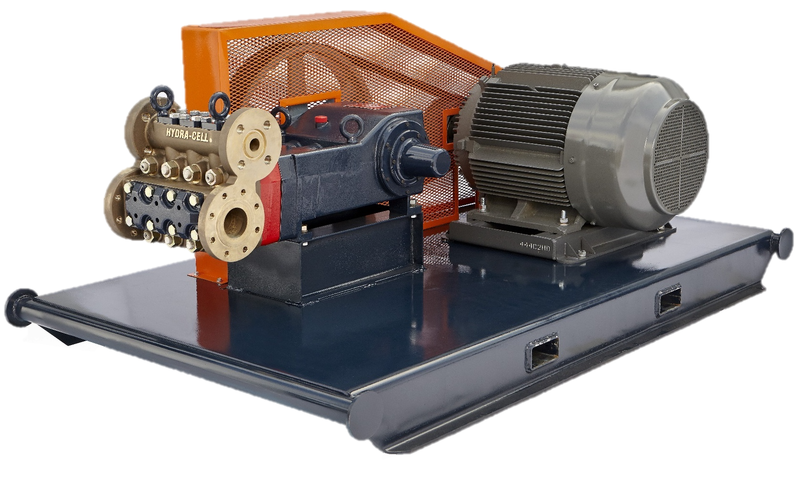
WANNER™ HYDRA-CELL® PRO | T&Q SERIES Pump Replacement Selling Strategy

Slide 2
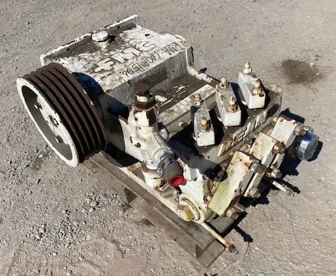
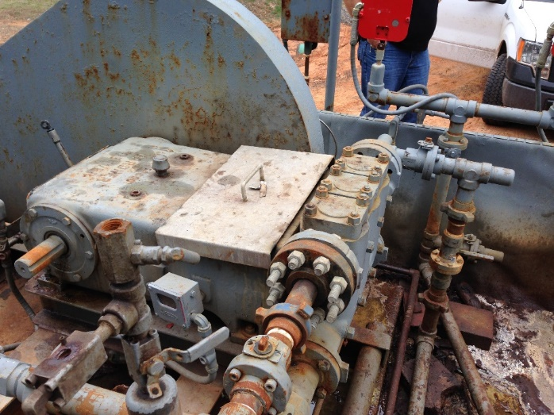
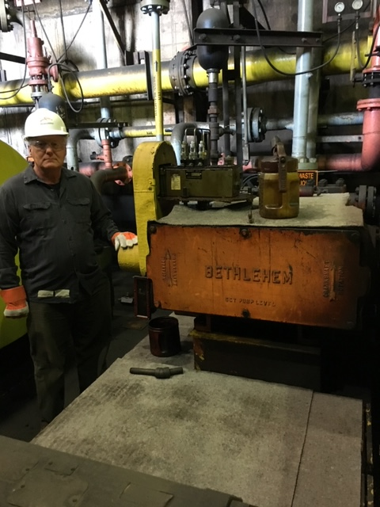
REPLACEMENT OPPORTUNITIES Obsolete High-Pressure, Plunger or Centrifugal

Slide 3
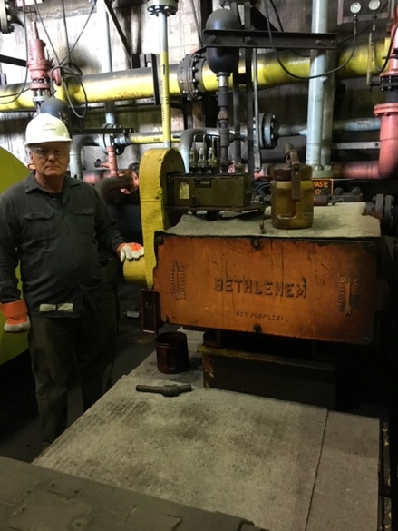
REPLACEMENT OPPORTUNITIES Customer Questions
Do you have any high-pressure applications?
Are your high-pressure pumps plunger or centrifugal?
How old are your pumps? Obsolete?
Are you having a difficult time getting replacement parts?
Are the replacement pumps costly?
Are you having to outsource or manufacture your own parts?

Slide 4
REPLACEMENT OPPORTUNITIES Customer Challenges
Parts Downtime
Discontinued or limited availability
Costly delays in delivery
High parts costs
Must manufacture your own
Pump Age / Obsolescence
Decreased mean time between failures
Packing leaks
Emission control issues
Increased maintenance
Increasing Cost of Ownership!

Slide 5
REPLACEMENT OPPORTUNITIES Brands
T & Q Series Pumps can replace the following piston / plunger pump brands:
FMC “BEAN”
Bethlehem
Wheatley
GASO
Oilwell
Peroni
Ajax
Gardner Denver
Kerr
Abel
NOV
RAM
Kobe
Worthington plunger
Weatherford
Union
Aldrich “IR”
Clyde Union

Slide 6
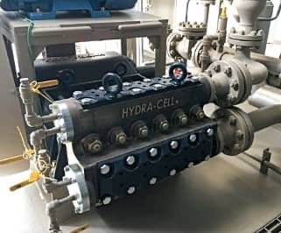
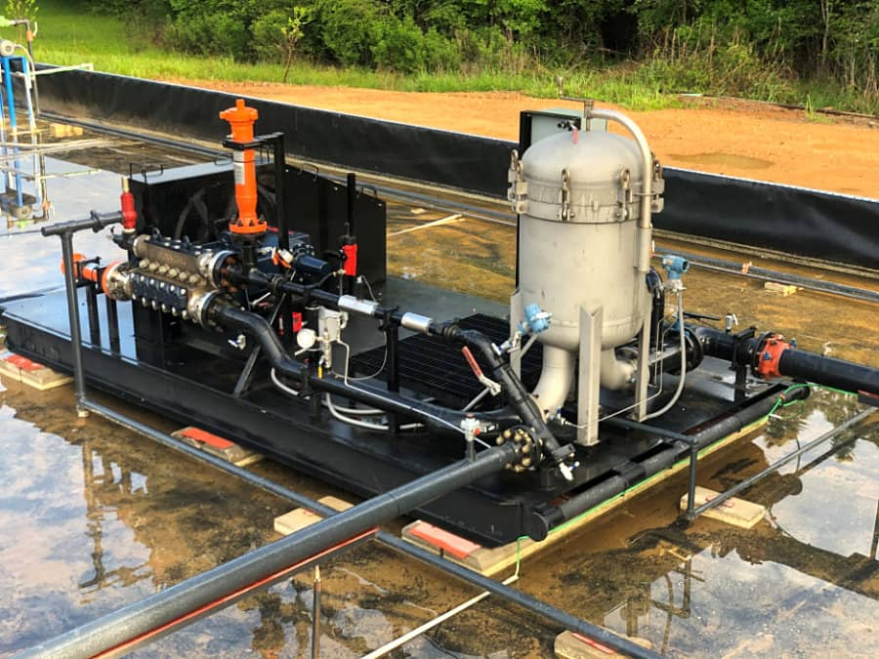
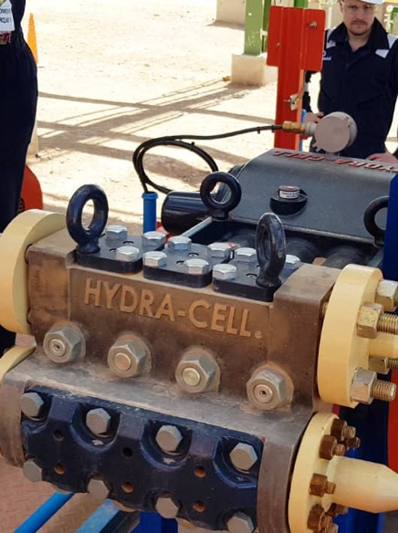
REPLACEMENT OPPORTUNITIES Primary Applications
T & Q Series pumps offer superior performance and reliability in:
Jet Pumps
Saltwater Injection or Disposal
Waste Water Disposal
Testing
Mine Dewatering
Natural Gas Liquids
Refining - Washdown
Fuel Transfer
Cleaning / Washing
Steam Generation
LACT Oil Transfer
Gas Dehydration
Spray drying
Slurry pumps – seal flushing
Mine – Tailings flushing

Slide 7
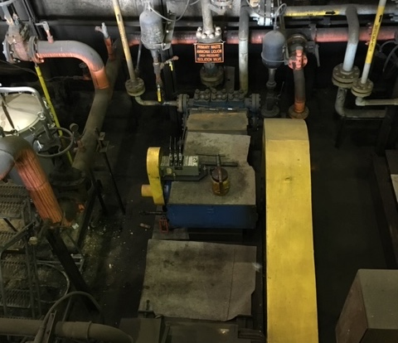
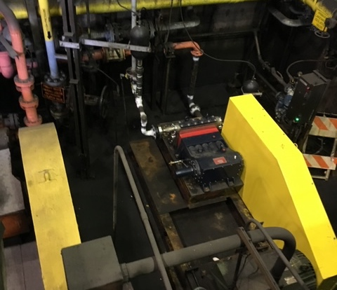
REPLACEMENT OPPORTUNITIES Installation

Slide 8
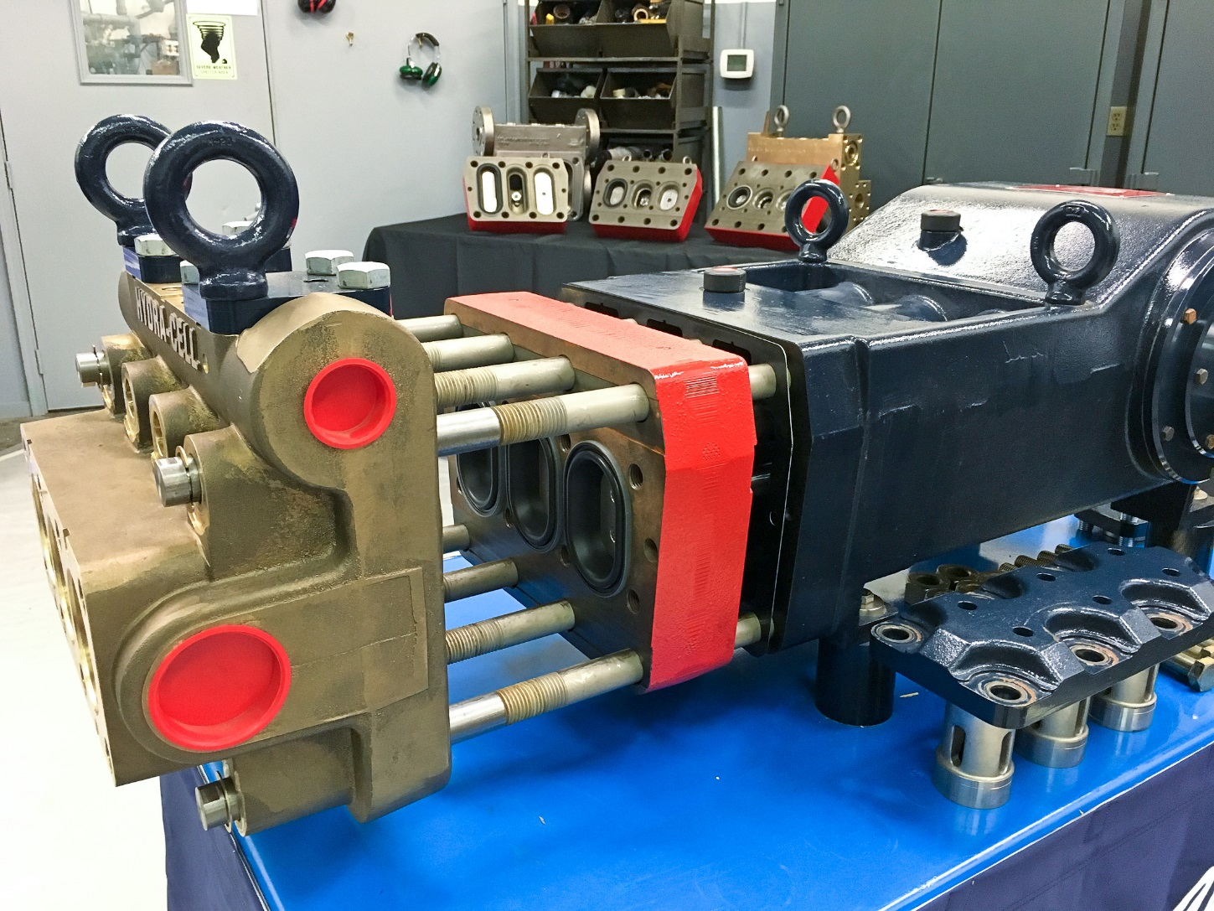
REPLACEMENT OPPORTUNITIES Ease of Maintenance
Manifold designed to unbolt and slide open for convenient service-in-place access
No lifting equipment is required to inspect the liquid end, just the Wanner toolkit
Valves accessible with piping installed for easy access

Slide 9
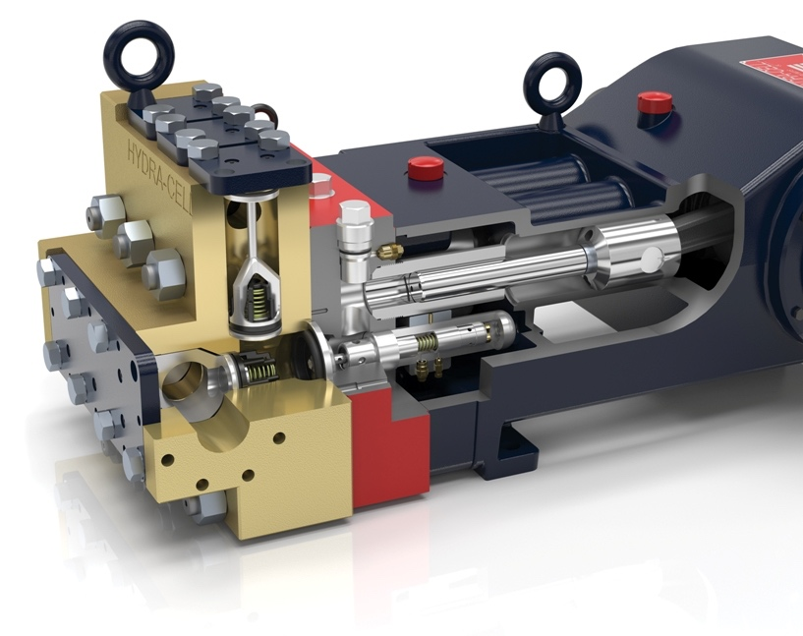
HYDRA-CELL PRO | T & Q SERIES Key Selling Points
Seal-less design
Can run dry indefinitely; operates against a closed inlet without damage
Handles particulates, abrasives and corrosive liquids and slurries
Pumped liquid is 100% contained = no emissions
Lower cost of ownership
Operational efficiency savings
Increase mean-time between failures
Reduce maintenance costs
Initial up-front cost savings

Slide 10
HYDRA-CELL PRO | T & Q SERIES TCO Case Study
 | Packed Plunger Pump #1 | Packed Plunger Pump #2 | Hydra-Cell Pro T Series
Corrective Maintenance Cost (Breakdown events; includes labor @$100 per hour + parts) | $33,000 | $44,940 | $6,441
Preventive Maintenance Cost (Includes labor @$100 per hour, spare parts) | $24,816 | $17,196 | $12,582
Energy Cost (8,760 working hours per year @$0.15 per KWh) | $35,478 | $35,478 | $35,478
Acquisition Cost (Including pump and driver skid) | $84,950 | $65,674 | $76,302
Total Cost per Pump (3 years) | $178,244 | $163,288 | $130,803
Hydra-Cell Pro Saving by Pump | $47,441 | $32,485
Life cycle cost of ownership; Polymer Injection Pumps acquisition + 3 years of operation

Slide 11
REPLACEMENT OPPORTUNITIES Key Industries & Applications
Oil & Gas
Pumping NGLs
We handle high suction pressures to maintain liquid state
Zero emissions (fines served for any leaks)
CO₂ (future opportunity)
Companies with ISO 14001 EMS initiatives
Steel Mills
Descaling & Pickling
Power Plants
Oxygen scavenging in high-pressure steam lines
Washdown/Cleaning
80-90c with chemicals (tanks, seals, compressor blades)
Fertilizer
Anhydrous Ammonia Urea
General Industrial
Displacing aged incumbent pumps
Discontinued pumps
Pumps with parts shortages / backorders
Multiple Industries
Spray Drying

Slide 12
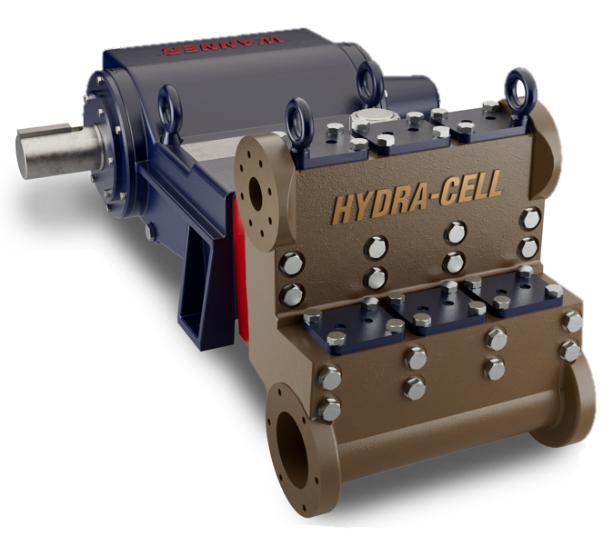
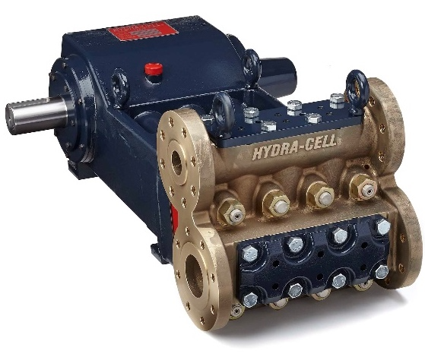
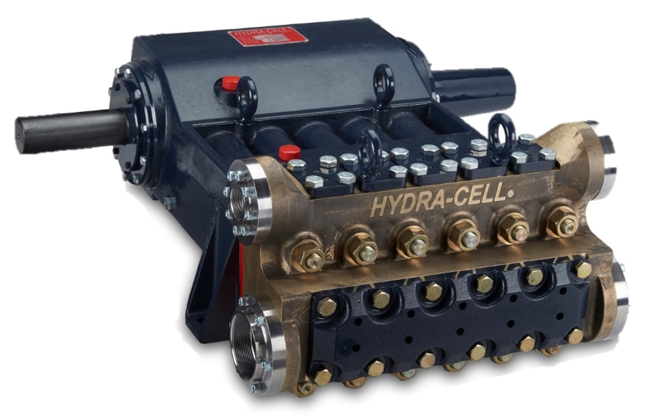
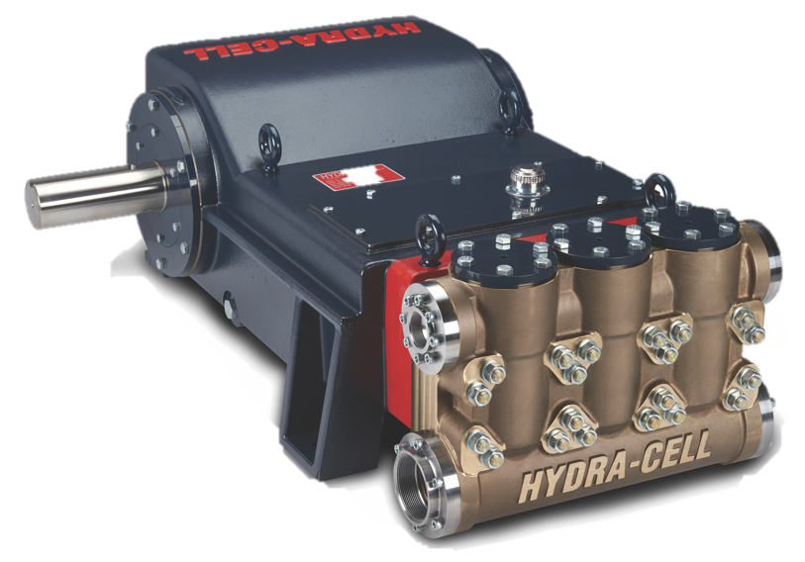
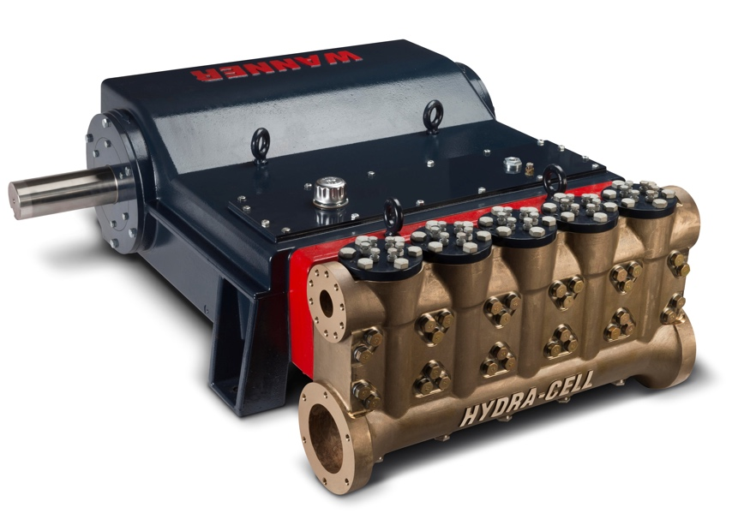
WANNER HYDRA-CELL PRO | T & Q SERIES Product Portfolio
T60 Pro Series
LOW PRESSURE
Max Flow: 93 gpm
Max Pressure: 1000 psi
T100 Pro Series
LOW PRESSURE
Max Flow: 96 gpm
Max Pressure: 2100 psi
MEDIUM PRESSURE
Max Flow: 45 gpm
Max Pressure: 3500 psi
HIGH PRESSURE
Max Flow: 26 gpm
Max Pressure: 5000 psi
Q155 Pro Series
LOW PRESSURE
Max Flow: 157 gpm
Max Pressure: 2100 psi
MEDIUM PRESSURE
Max Flow: 75 gpm
Max Pressure: 3500 psi
T200 Pro Series
LOW PRESSURE
Max Flow: 202 gpm
Max Pressure: 2000 psi
MEDIUM PRESSURE
Max Flow: 94 gpm
Max Pressure: 3500 psi
HIGH PRESSURE
Max Flow: 72 gpm
Max Pressure: 4500 psi
Q330 Pro Series
LOW PRESSURE
Max Flow: 330 gpm
Max Pressure: 2000 psi
MEDIUM PRESSURE
Max Flow: 153 gpm
Max Pressure: 3500 psi
HIGH PRESSURE
Max Flow: 118 gpm
Max Pressure: 4500 psi

