Slide 1


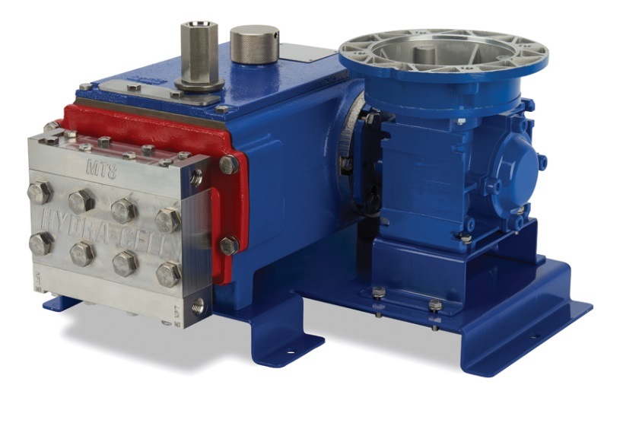

MT8 METERING PUMP
October 31, 2017
Wanner Engineering, Inc.

Slide 2
What is a metering pump?
A metering pump moves a precise volume of liquid in a specified time period providing an accurate flow rate. Delivery of fluids in precise adjustable flow rates is sometimes called metering.
The term "metering pump" is based on the application or use rather than the exact kind of pump used, although some types of pumps are far more suitable than most other types of pumps.¹
¹From Wikipedia

Slide 3
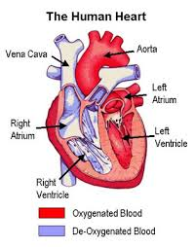
What is a metering pump?
Each of us has one with us right now.

Slide 4
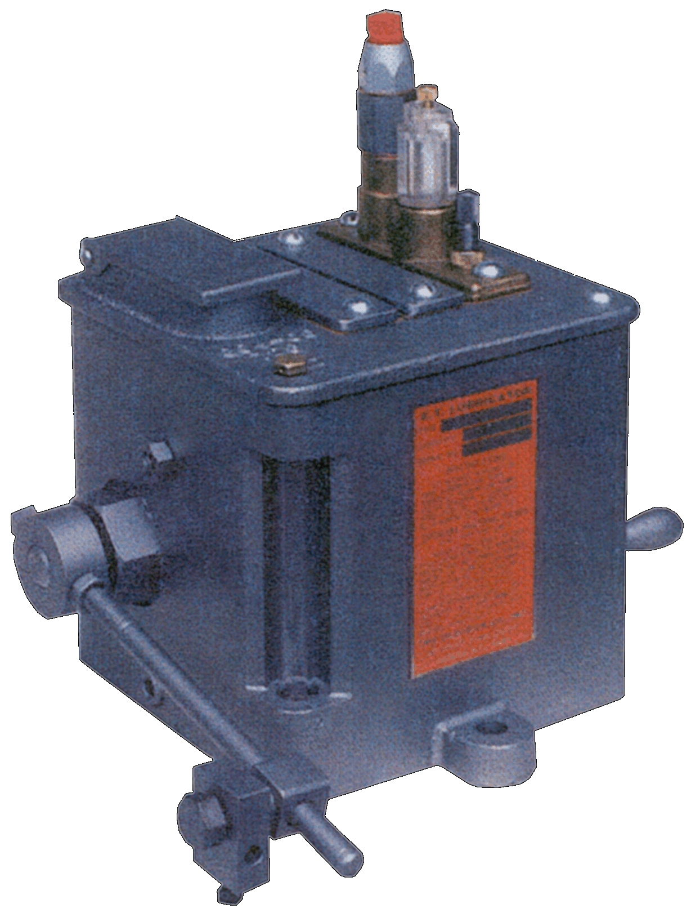
What is a metering pump?
The first metering pump was actually a lubricator, designed 150 years ago by Hills-McCanna, to oil the metal chains on steamboats.
Pictured here is its descendent.

Slide 5
What is a metering pump?
A metering pump is an essential component of many industries today.
As new processes emerge and higher levels of accuracy are required, metering pumps are becoming necessary in many different phases of production.
Metering pumps should be used whenever a process requires more than a transfer of fluid. This could mean the pumpage of a fixed amount of fluid into an ongoing process or a varying amount of fluid controlled by the needs of an ongoing process.

Slide 6
What is a metering pump?
Metering pump technology has not changed dramatically in the past few decades
Hydra-Cell’s Metering Solutions Pump group has introduced new technology into the metering pump world
The MT8 pump is our latest innovation – we want to introduce it to you and explain what makes it unique

Slide 7
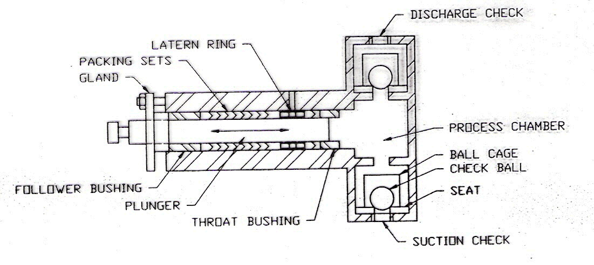
What is a metering pump?
Metering pumps can be classified as:
Plunger type – where the plunger comes in direct contact with the process fluid

Slide 8
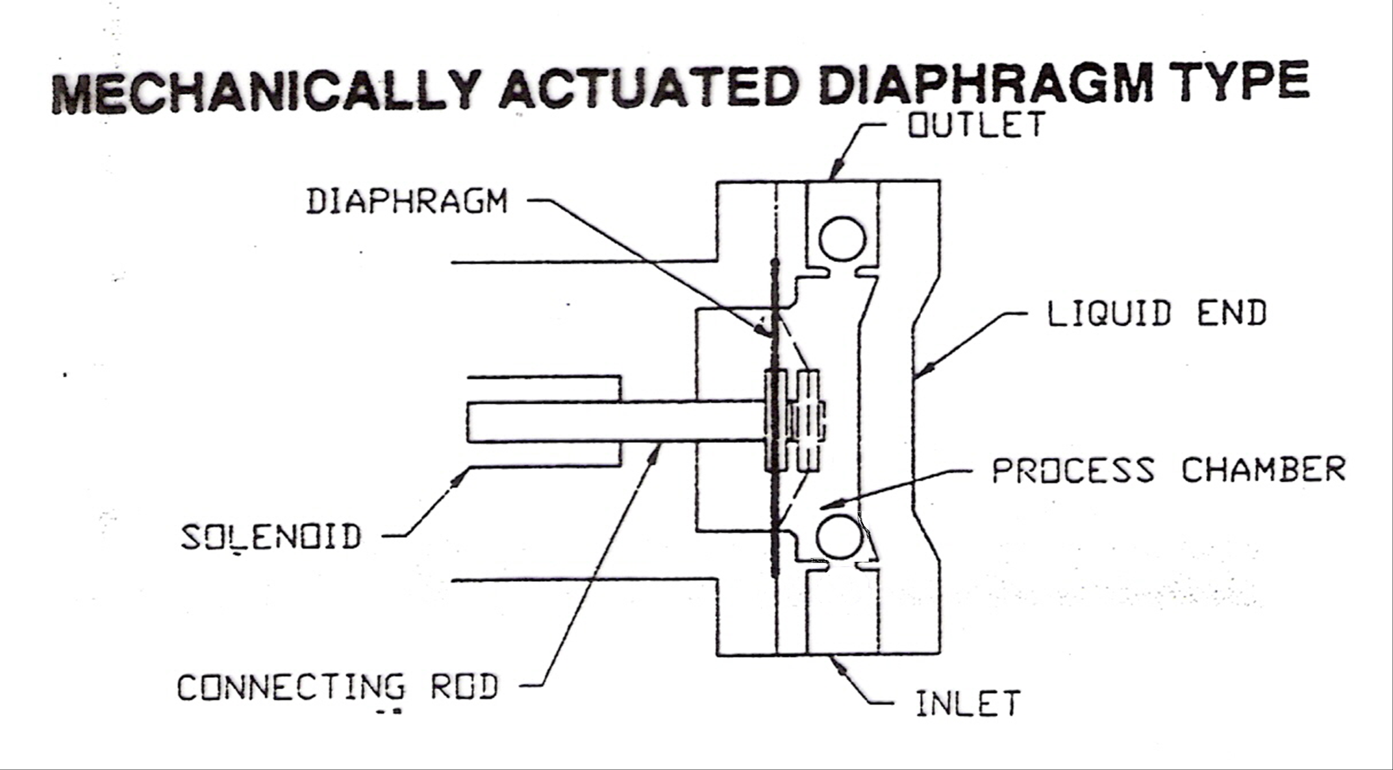
What is a metering pump?
Metering pumps can be classified as:
Mechanically-actuated (Solenoid or Motor Drive) type – where an electromagnet or motor/worm gear/cam reciprocate a piston connected to a diaphragm

Slide 9
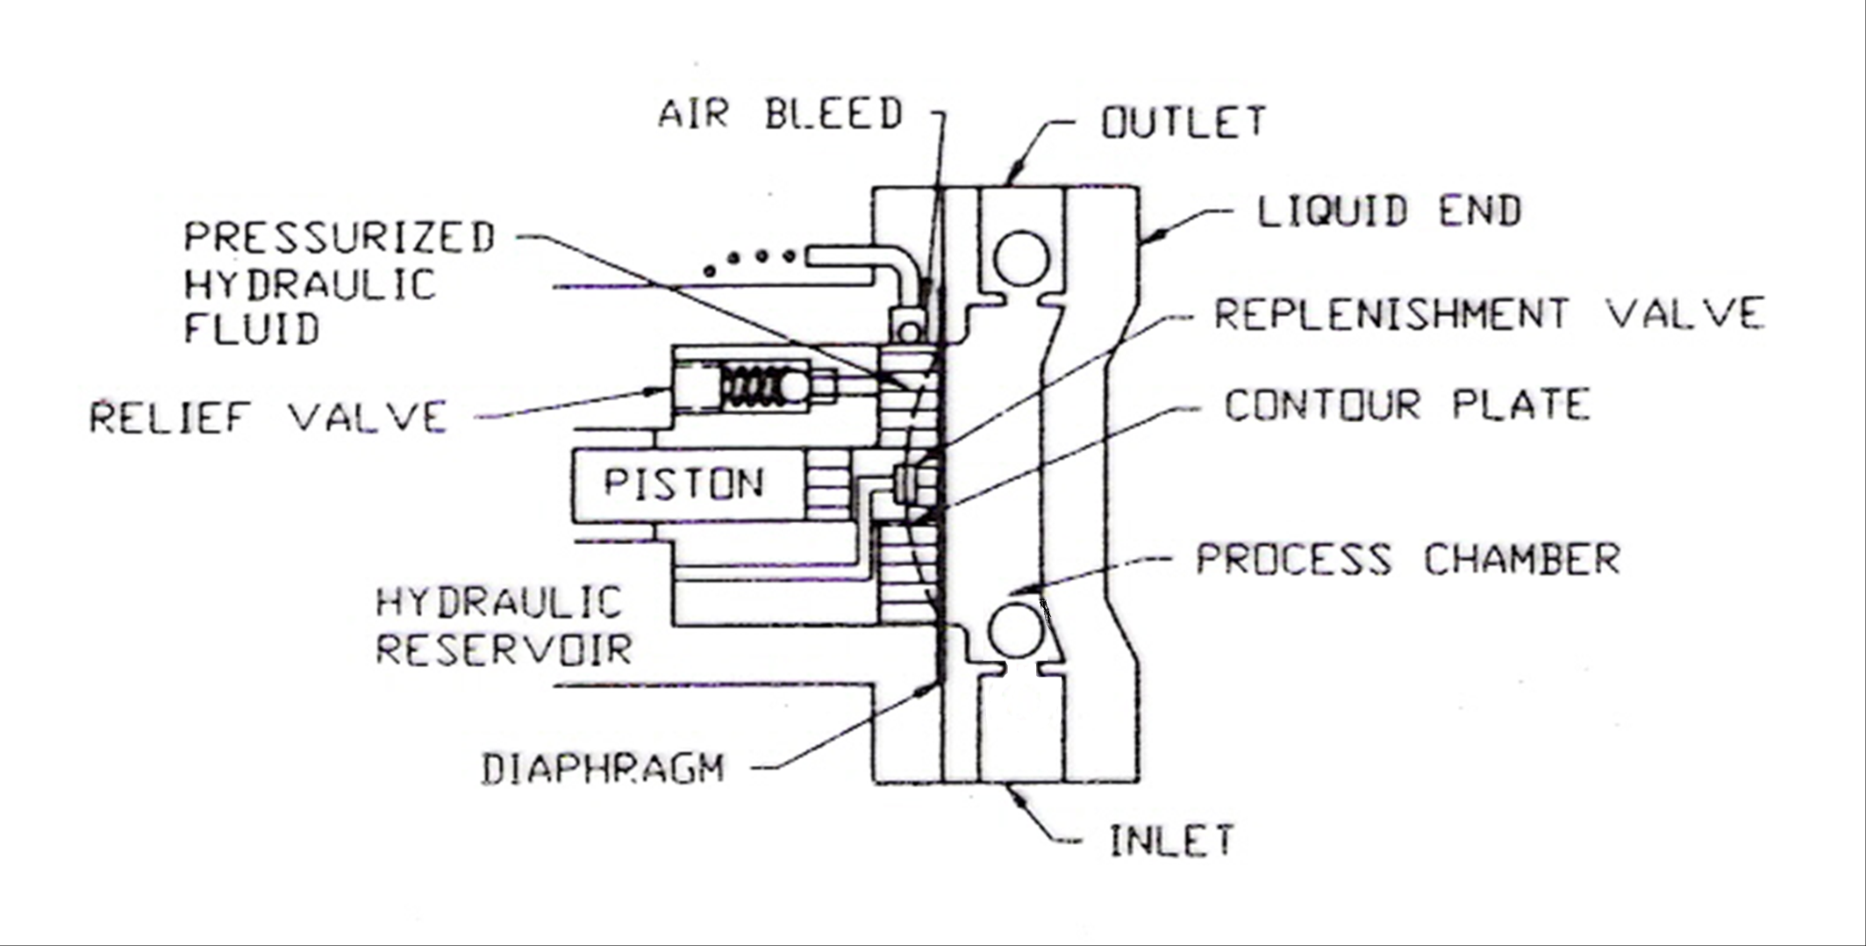
What is a metering pump?
Metering pumps can be classified as:
Hydraulically-actuated/balanced diaphragm type – where hydraulic oil replaces the mechanical connection of the piston to the diaphragm and the oil displaced by the piston actuates the diaphragm

Slide 10
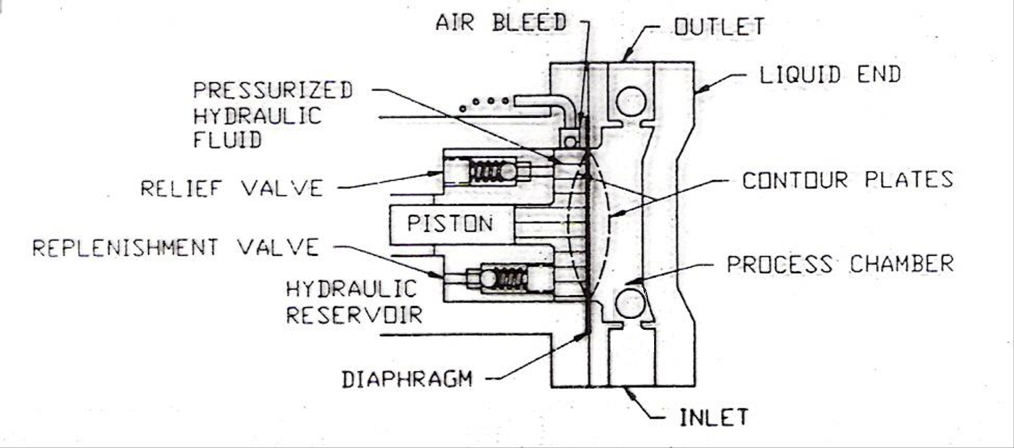
What is a metering pump?
Hydraulically actuated/balanced metering pumps require replenishment of the actuating oil lost through air bleed and leakage along the piston to maintain accuracy. This is accomplished in two ways:

Slide 11
What is a metering pump?
Vacuum Replenishment Type
Mechanical Replenishment Type

Slide 12
What is a metering pump?
How often and how well a pump replenishes the actuating fluid has a significant impact on the accuracy of the pump.
With both of these methods, replenishment does not occur until a vacuum is sensed in the liquid end or a mechanical valve is opened by a fully-retracted diaphragm.
Why is this important?
The MT8 features a replenishment system that compensates for any decrease in actuating fluid on every stroke, ensuring optimum accuracy.

Slide 13
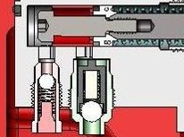
Hydra-Cell MT8 Technology Advantages
This patented replenishment system not only maintains accuracy which exceeds API 675 performance requirements, but also provides diaphragm protection. It prevents the diaphragm from moving too far forward or backward, protecting the pump from damage in blocked suction conditions.

Slide 14
Hydra-Cell MT8 Technology Advantages
And…the pump can run dry indefinitely without damage!

Slide 15
Hydra-Cell MT8 Technology Advantages
The single diaphragm movement causes significant pulsation and creates a slug-like delivery of process fluid
Why is this important?
The MT8 features a triplex diaphragm design in one liquid end which creates virtually “pulse-free” linear flow

Slide 16
Hydra-Cell MT8 Technology Advantages
Minimizing or eliminating pulsations in metering pumps is significant because pulsations:
May require the purchase and maintenance of large, expensive dampeners
Create safety and housekeeping issues
Cause friction losses
Increase noise levels, especially in lost motion pump designs that feature metal to metal contact
Result in process fluid flows that are slugs which average out to a specific gph

Slide 17

Hydra-Cell MT8 Technology Advantages
The triplex design of the MT8 minimizes the negative effects of pulsation

Slide 18
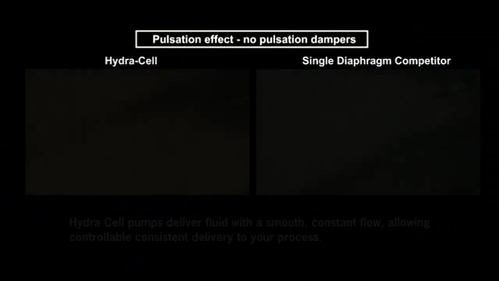
Hydra-Cell MT8 Technology Advantages
In addition, the resulting linear flow allows for the precise delivery of process fluids that remains constant

Slide 19
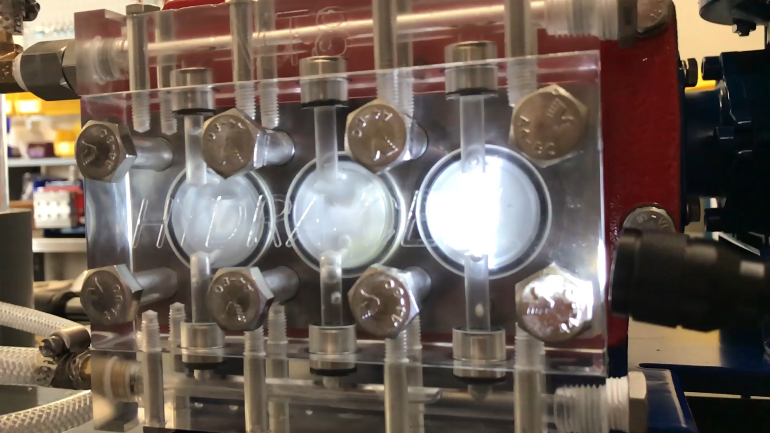
Hydra-Cell MT8 Technology Advantages
As air entrapment is a common problem with metering pumps, the MT8 has been designed to effectively purge air from the liquid end.

Slide 20
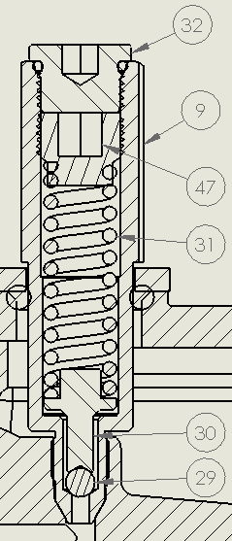
Hydra-Cell MT8 Technology Advantages
Internal Pressure Relief Valve
  Provides internal protection for over-pressurization of the pump
  Does not negate the need for external PRV

Slide 21
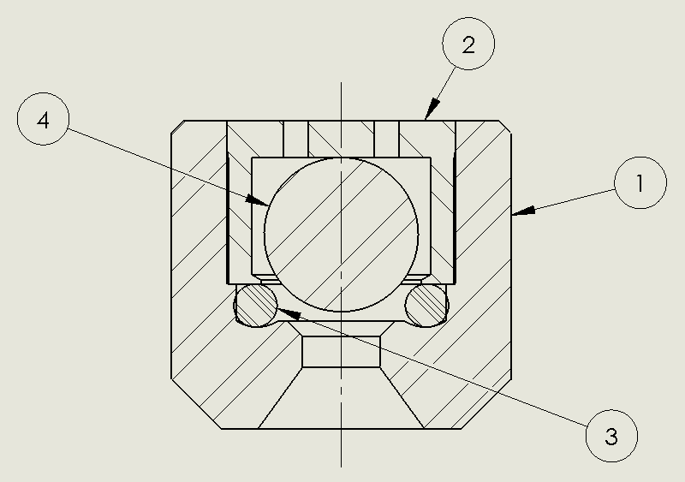
Hydra-Cell MT8 Technology Advantages
Check valves
  Cartridge one-piece check valves with easy access for simplified maintenance
  Currently available in 316SS, Hastelloy and Alloy 20

Slide 22
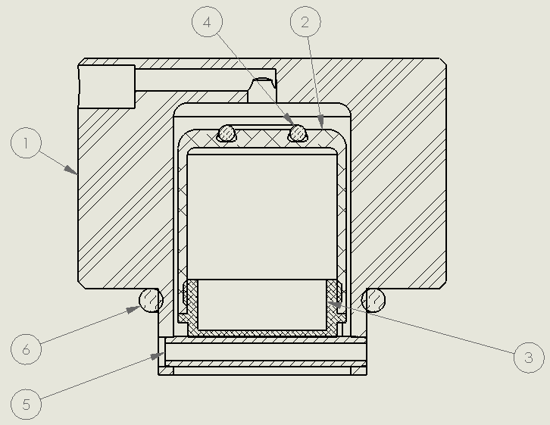
Hydra-Cell MT8 Technology Advantages
Sealing Oil Cap

Slide 23
MT8 Performance Points
Maximum Flow 8.0 GPH (30.28 LPH)
Minimum Flow 0.06 GPH (0.227 LPH)
Maximum Outlet Pressure 3500 PSI (241 bar)
Maximum Inlet Pressure 500 PSI (34 bar)
Meets/exceeds API 675 performance standards for Linearity, Repeatability and Steady State Accuracy.

Slide 24
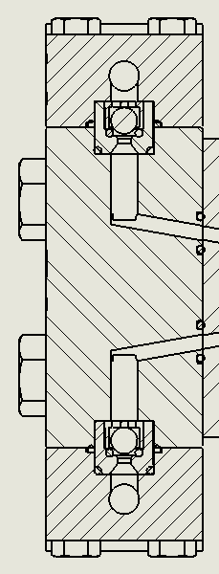
MT8 Options
Manifold/Liquid End
  Currently available in 316SS, PVC, PVDF, Hastelloy and Alloy 20
e
– Optimized flow design along with non-spring loaded check valves makes priming quick and easy

Slide 25
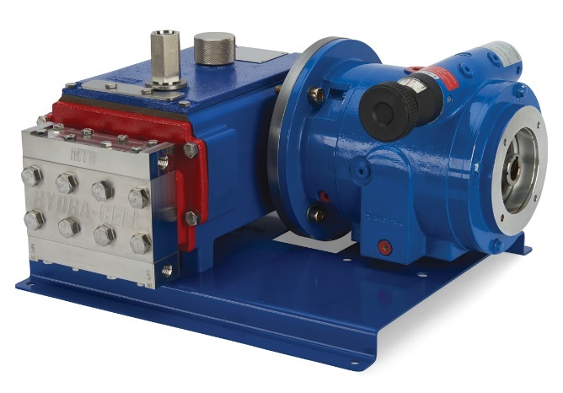
MT8 Options
Gear box
  Motor flanges: Nema 56C, 143/145TC; IEC 63 B5, 71 B5, 80 B5; Gear ratios of 5:1, 10:1, 20:1, 30:1, 40:1, 50:1, 60:1, 80:1, 100:1
  Available with manual adjust

Slide 26
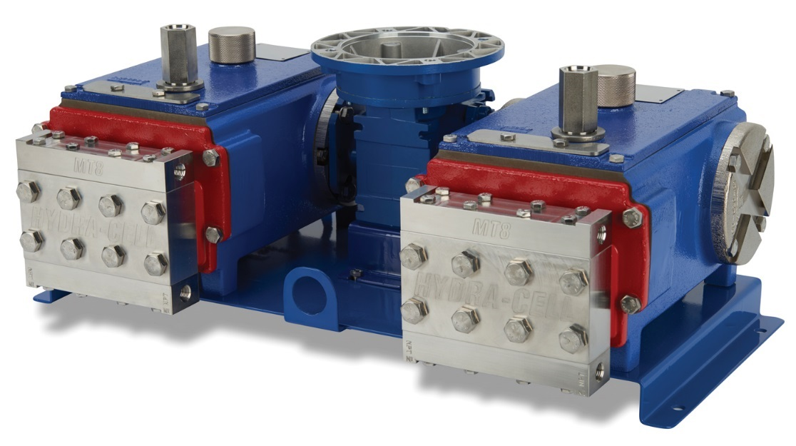
MT8 Options
Can be duplexed
  Allows for doubling of flow rate
  Proportional injection of different fluids
  Installed spare

